Slide 1
Employee Data Analysis using Excel
STUDENT NAME:RAECHEL.L
REGISTER NO:422200903
DEPARTMENT:III B.COM(ISM)
COLLEGE: SHRI KRISHNASWAMY COLLEGE FOR WOMEN

Slide 2
PROJECT TITLE
SALARY AND COMPENSION ANALYSIS THROUGH EXCEL DATA MODELING

Slide 3


AGENDA
Problem Statement
Project Overview
End Users
Our Solution and Proposition
Dataset Description
Modelling Approach
Results and Discussion
Conclusion
3/21/2024 Annual Review

Slide 4

PROBLEM STATEMENT
"How can we use Excel data modeling to analyze and optimize salary and compensation structures within an organization to ensure fairness, competitiveness, and alignment with industry standards?"
Key Objectives
Analyze Current Compensation Structure: Understand the current distribution of salaries and benefits within the organization.
Benchmark Against Industry Standards: Compare internal compensation data with industry standards and competitors.
Identify Discrepancies: Find disparities in compensation across different roles, departments, or demographics

Slide 5

PROJECT OVERVIEW
Project Objective: To utilize Excel data modeling techniques to analyze and optimize the salary and compensation structure of an organization, ensuring fairness, competitiveness, and alignment with industry standards.
Scope: This project involves collecting, cleaning, analyzing, and visualizing salary and compensation data to evaluate and improve the current compensation structure. The analysis will include benchmarking against industry standards, identifying discrepancies, and recommending adjustments to achieve a balanced and competitive compensation strategy.
.

Slide 6

WHO ARE THE END USERS?
1. Human Resources (HR) Department
Role: HR professionals are responsible for managing employee compensation, ensuring equitable pay practices, and aligning compensation with organizational goals.
Needs: HR uses the analysis to review and adjust salary structures, develop compensation policies, and address pay discrepancies. They also use insights to ensure compliance with legal standards and industry benchmarks.
2. Finance Department
Role: Finance teams manage the organization’s budget, including salary and compensation expenses.

Slide 7

OUR SOLUTION AND ITS VALUE PROPOSITION
Solution Description: This solution leverages Excel data modeling techniques to perform a comprehensive analysis of salary and compensation structures within an organization. The analysis includes evaluating current compensation practices, benchmarking against industry standards, identifying disparities, and recommending optimizations to enhance fairness, competitiveness, and alignment with organizational goals.
Key Components of the Solution
Data Collection and Integration
Internal Data: Collect detailed compensation data including salaries, bonuses, benefits, job titles, departments, and employee demographics.
External Data: Obtain industry benchmarks for comparison.

Slide 8
Dataset Description
Dataset Overview: The dataset used for salary and compensation analysis will typically consist of multiple tables that capture various aspects of employee compensation and related data. This comprehensive dataset is crucial for conducting an in-depth analysis and generating actionable insights.
Key Components of the Dataset
1. Employee Data Table
Description: Contains detailed information about individual employees and their compensation components.
Columns:
Employee ID: Unique identifier for each employee.
Name: Full name of the employee

Slide 9

THE "WOW" IN OUR SOLUTION
1. Comprehensive and User-Friendly Dashboard
Interactive Visualization:
Dynamic Dashboards: Create interactive dashboards with slicers and pivot charts that allow users to explore data across different dimensions (e.g., department, job title, location) easily.
Real-Time Insights: Enable real-time data updates and analysis with linked charts and tables, providing up-to-date visual representations of compensation data.
Customizable Views:
Tailored Analytics: Offer customizable views that cater to different user needs, such as high-level executives, HR managers, and compensation analysts, allowing them to focus on the metrics most relevant to them.
3/21/2024 Annual Review
9

Slide 10
MODELLING
Modeling is a critical step in analyzing salary and compensation data. It involves creating structured, dynamic, and scalable models in Excel to facilitate in-depth analysis, scenario planning, and optimization. Here's how you can approach modeling in the context of salary and compensation analysis:
1. Data Structure and Integration
Objective: Organize data effectively to support comprehensive analysis and ensure consistency across the model.
Tasks:
Design Data Tables: Create structured tables for different data components (e.g., Employee Data, Benchmark Data, Compensation Components).
Establish Relationships: Use Excel’s data tools to establish relationships between tables, such as linking employee IDs with compensation data and benchmarks
10

Slide 11
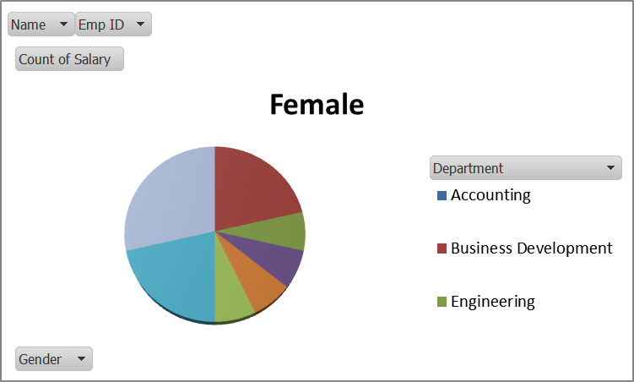
RESULTS
11

Slide 12
conclusion
The Salary and Compensation Analysis through Excel Data Modeling is a powerful approach to understanding and optimizing an organization's compensation structure. By leveraging Excel's robust data modeling and analysis capabilities, you can gain valuable insights into compensation practices, ensure fairness, and align with industry standards. Here’s a summary of the key aspects and benefits of the solution:
Key Takeaways
Comprehensive Data Integration
Structured Data: Integrate and organize various data components, such as employee compensation details, industry benchmarks, and demographic information, into a coherent and accessible model.
Dynamic Analysis: Ensure data is linked and updated dynamically to reflect the most current information.

